Slide 1
ASX Status Update
E. Hosang (CAE)
June 2026
Notes:
Welcome to CAE!

Slide 2
Work to date
Collection of Use Cases.
Mostly complete, but new use cases are being found as drones are deployed in conflicts.
Survey of IEEE Robotics standards and associated models.
Complete
Use Case document – breaks down use cases to entities and messages (Initialization, Orders, Reports).
Complete for now – further effort offers diminishing returns.
Message definition spreadsheets – taking messages from Use Case document and defining them using C2SIM entities.
Ongoing
Start of OWL model based on concepts from standards.

Slide 3
Going forward
Work Breakdown Structure defined to get from here to having something for balloting.
Created using Microsoft Project, but exported to Excel spreadsheet.
Can be created as PDF if needed.
Note: WBS and all related items can be found in GitHub repository under Proposed Extension Working Materials.
See next slide

Slide 4
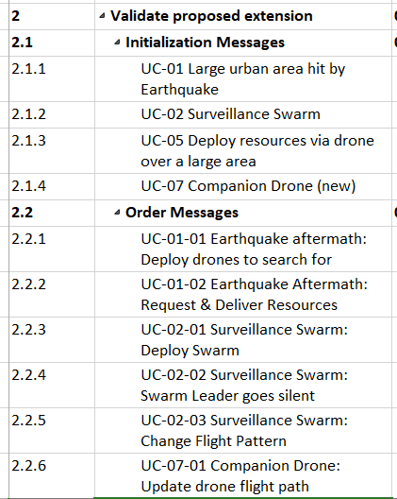
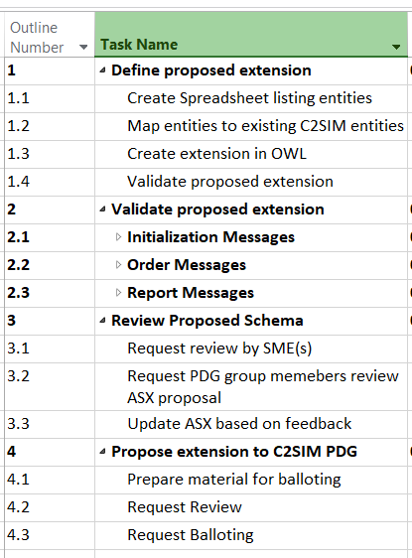
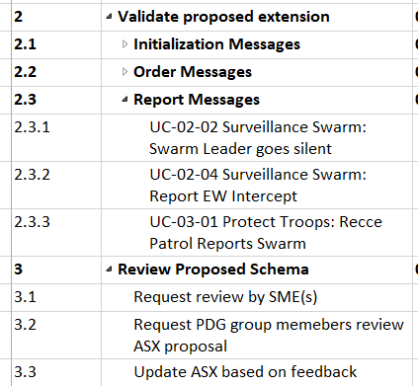

Slide 5
Activity Explanation
From use case breakdown, key concepts were identified.
They have been captured in a spreadsheet.
Next step is to identify parent classes/types in existing C2SIM standards.
In parallel they can be used in the OWL capture of the ontology.
Once the standard is created, the messages from the use case documents can be completed.

Slide 6
Discussion of Robotics Concepts
Do we want to add entities that capture concepts from Robotics standards to the ASX model?
Sensor ⊑ ElectricDevice
Actuator ⊑ ElectricDevice
Swarm ⊑ CollectiveRoboticSystem
UAV ⊑ Robot
UGV ⊑ Robot
Sensors ⊑ Robot Part
Notes:
m

Slide 7
Notes from meeting
To add to Use Case document:
Use of USV to rescue downed pilots – new use case.
Companion Drones use case.
Action Item: Elizabeth to prepare tutorial of how to capture a message.
Next meeting: Thursday, July 9.

Slide 8

Thank you!

